Slide 1
Week 2: Demand for Health
HPM 6503
Spring 2026
Nada Boualam, PhD

Slide 2
Week 2: Outline
AI Policy
1. Review of the PPF
  Constraint shifters
  Opportunity cost on the graph
2. Consumer choices:
  Preferences & utility
  Budget Constraints
  Equilibrium
3. Demand for Health & Medical care
  From Utility to Demand
  Definitions
  Demand shifters
4. Elasticities
  Within price
  Cross price

Slide 3
AI Policy
First problem set will be assigned after class
You are welcome to use by generative AI tool to study, but it is not recommended to use it to answer the problem sets. Generative AI is a tool - that can be wrong - not a replacement for your own thinking. If you do not study for the problem sets, you will most likely be underprepared for the exams.
  If you are caught using generative AI to answer problem sets, it will be treated as a violation of academic integrity, and referred to the office of student conduct.

Slide 4

PPF Review
When poll is active respond at:
PollEv.com​/nadaboualam947
Send nadaboualam947 and your message to 22333

Slide 5
1. PPF: Production Possibility Frontier - Review
PPF tells us:
What we can produce with our resources
How opportunity cost of goods changes
What is efficient / inefficient for us to choose
What is impossible for us to choose
Opportunity cost: how much unit B do I have to give up to get 1 more unit A?
→ Slope of the PPF

Slide 6
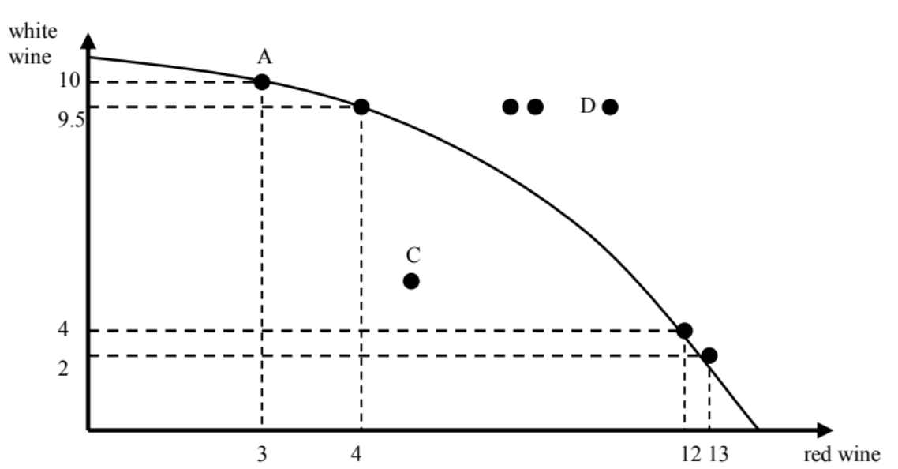
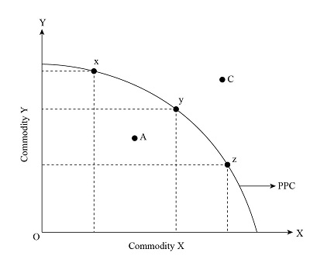
Review of the PPF
Which point(s) is/are inefficient?
What happens if you suddenly make more money?
What happens if you suddenly make less money?
What does x represent?
At point x, what is the opportunity cost of X in terms of Y?
B
Notes:
At point A, you have to give up 0.5 white wine to get 1 red wine → opportunity cost of red wine is 0.5 white wine
At point B, you have to give up 2 bottles of white wine to get 1 red wine → opportunity cost of white wine is 2 red wine
You have to give up more and more white wine to get red wine

Slide 7
Demand for Medical Care

Slide 8
Utility - Definition, uses
Definition
Utility: welfare, happiness, satisfaction, well-being → ranking of preferences
Recall from last week:
Decision-making at the margin: would an extra unit of this good increase my utility?
Rational consumers maximize their utility
Notes:
(given their constraints)

Slide 9
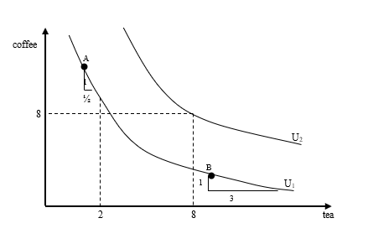
From Utility to Demand
Indifference Curves: shows alternative bundles of goods from which the individual derives equal levels of utility → the consumer is indifferent
Notes:
allow us to discuss a consumer’s preference over 2 goods
Indifference curves represent bundles of two goods that give the consumer the same utility. They are bowed in because we usually assume a “preference for variety” or strictly convex preferences: people like balanced bundles and have a diminishing marginal rate of substitution (MRS).
A PPF shows the maximum combinations of two goods the economy can produce with given resources and technology. The usual bowed‑out shape reflects increasing opportunity cost: resources are not equally well‑suited to producing both goods.
As you produce more of good A, you must pull in resources that are progressively less efficient at making A and better at making B, so you give up larger and larger amounts of B for each extra unit of A.

Slide 10
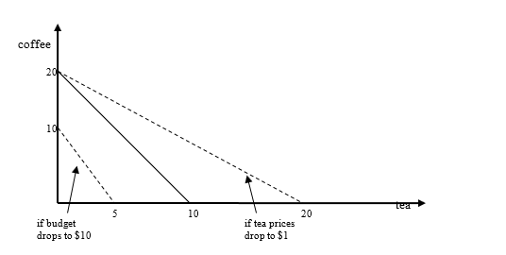
From Utility to Demand
Budget constraints: indicate the bundles of goods a consumer can afford given their income

Slide 11
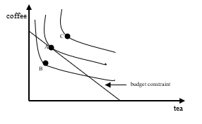
From Utility to Demand
Consumer Equilibrium: Consumer’s job is to get the most happiness (utility) they can, given their budget
Demand: Which bundle of goods maximizes utility subject to the budget constraint?
Notes:
Simplistic, but powerful tool: replace tea with “soda” and coffee with “candy bar.” Soda tax goes in place, increases price of soda, shifts budget. Consume less soda – this is intended effect – but consume more candy! Law of unintended consequences. Empirical question, but evidence thus far shows that soda taxes have done just this.

Slide 12
Diminishing Marginal Returns
Now Add: The Law of Diminishing Marginal Returns of X on Y
The rate at which your utility increases from getting X over Y will diminish the more of X you already have

Slide 13
Economic Definition of Medical Care
Definition
Medical Care: Goods & services that maintain, improve, or restore a person’s physical or mental well-being
How is medical care measured?
Services are heterogeneous → no singular unit
Default measure is spending on medical care
Quality is not uniform
Notes:
Most medical care are services

Slide 14
Demand for Health & Health Care
Demand for medical care is a derived demand. People consume healthcare to improve or maintain their health. Utility is derived from health, not health care.
Law of diminishing marginal utility: the marginal utility of health improvements diminishes in magnitude as health status increases
Law of diminishing marginal productivity: The marginal impact on health of increased spending for medical care diminishes as the level of spending increases.
Non-healthcare spending externalities: additional spending on non-medical interventions may have a greater impact on health than additional spending on medical care

Slide 15
Grossman Model: Demand for care is a derived demand
People demand health, not health care. Health is a durable capital good that individuals invest in over their lifetime.
Health serves 2 purposes:
Consumption value
Investment value
Health depreciation: Health stock depreciates over time at an increasing rate (with age). This drives the need for ongoing investment in health maintenance.
Higher wages → greater demand for health (more earnings to protect)
Higher education → greater demand for health (more productive use of healthy time)
Notes:
Consumption value – directly yields utility (you feel better when healthier)
Investment value – increases earnings by enabling more productive work time
As depreciation accelerates, optimal health stock falls.
Same as I said before, re: law of diminishing returns
→ The less health you have, the more you value your health

Slide 16
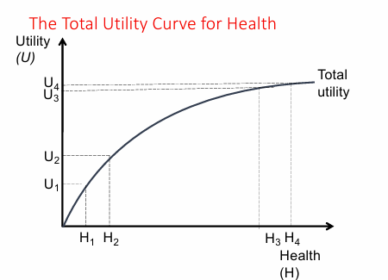
Law of diminishing marginal utility (of health)
Law of diminishing marginal utility: each additional improvement in health generates an ever smaller increase in utility.
Notes:
Y is what you get
X is what you use
The increase in health from H0 to H1 causes utility to increase from U0 to U1, while an equal increase in health for H2 to H3 results in a smaller increase in utility from U2 to U3.
The total utility curve is upward sloping and depicts the relation between an individual’s stock of health and utility. The positive slope indicates that total utility increases as an individual’s stock of health improves.

Slide 17
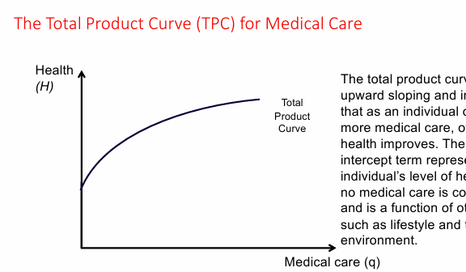
Law of diminishing marginal productivity (of health)
Law of diminishing marginal productivity: health increases at a decreasing rate when additional units of health care are consumed, holding all other inputs in the health production process constant.
Notes:
Y is what you get
X is what you use
TPC = how much Y you produce given how much X you consume
You produce health by consuming health care
The positive intercept term represents the individual’s level of health when no medical care is consumed and is a function of other factors such as lifestyle and the environment.

Slide 18
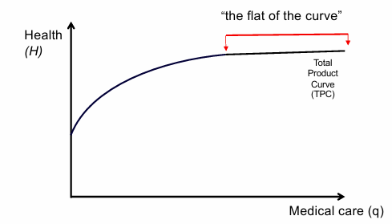
Law of diminishing marginal productivity (of health)
Most of US spending on healthcare corresponds to the flat of the curve. → higher spending, but same (or worse) health status than other countries
Notes:
Y is what you get
X is what you use
You produce health by consuming health care
The positive intercept term represents the individual’s level of health when no medical care is consumed and is a function of other factors such as lifestyle and the environment.

Slide 19
Law of diminishing marginal productivity (of health)
What affects the TPC?
Education shifts up & rotates it upward
Disease shifts down & rotate it upward
Income shifts it up
Technological advances either increase productivity or occur in the flat of the curve
Other spending could shift TPC up or down (e.g. public health, preventive care, nutrition, exercise)
Notes:
Education rotate upwards because you are more capable of making use of the doctors visit
Disease rotate up bc youre sick so you benefit more from the doctors visit
[draw on board]

Slide 20

Production function of health
Definition
Social Determinants of Health: conditions in which people are born, grow, live, work and age, and people’s access to power, money and resources

Slide 21

Recap, Questions, & Break
Notes:
Health is something that generates utility, although subject to the law of diminishing marginal utility • The consumption of medical care can improve or maintain health, although subject to diminishing marginal productivity • Utility-Maximizing Rule -- Consumers act to maximize utility

Slide 22
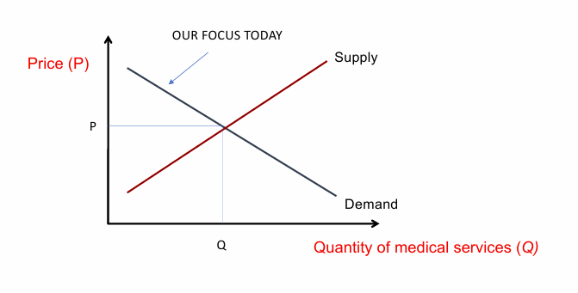
The Demand Curve for Medical Services
Which way does the demand curve slope?
Notes:
From utility, can get demand curve.
Demand curve
• Inverse (or negative) relationship between price and quantity
• Downward sloping: Reflects (diminishing) marginal benefits/utility of additional units of consumption and substitution effects
• Price (faced by the consumer)
• Per-unit out-of-pocket expense the consumer incurs, after third party payment taken into account
• All other things being equal (ceretis paribus), a changes in the price demand curve of a good or service results in movement up or down its demand curve

Slide 23
The Demand Curve for Medical Services
Notes:
From utility, can get demand curve.
Demand curve
• Inverse (or negative) relationship between price and quantity
• Downward sloping: Reflects (diminishing) marginal benefits/utility of additional units of consumption and substitution effects
• Price (faced by the consumer)
• Per-unit out-of-pocket expense the consumer incurs, after third party payment taken into account
• All other things being equal (ceretis paribus), a changes in the price demand curve of a good or service results in movement up or down its demand curve

Slide 24
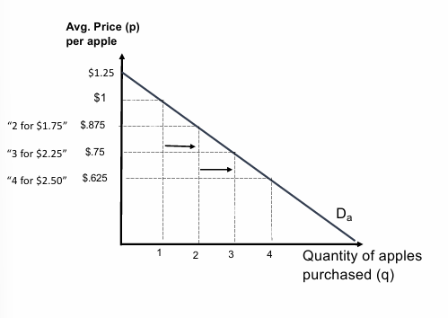
Basics of Demand Curve
This demand curve reflects the Marginal Benefit (MB) to an individual consumer from purchasing different amounts (q) of apples
MB = ΔTB / ΔQ
MB = how much more are you paying for the additional apple?
Demand is a function of:
Consumer preferences
Substitution effects
Notes:
Downward sloping because of:
Consumer preferences (including the effects of diminishing marginal utility)
Substitution effects (e.g., oranges)
MB of next apple purchased depends on how many apples have already been purchased,

Slide 25
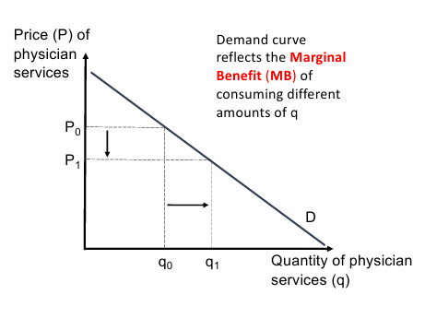
Demand Curve for Physician Services
Notes:
Changes in price → movement along the curve
Other changes → movement of the curve

Slide 26
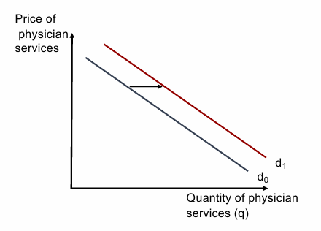
Economic variables that impact demand
Income
2. Time, transportation, costs of seeking care
3. Price of other goods
Complements
Substitutes
Notes:
Complements: goods used jointly
Substitutes: satisfy the same wants

Slide 27

Economic variables that impact demand
Income
2. Time, transportation, costs of seeking care
3. Price of other goods
Complements
Substitutes
Notes:
Complements: goods used jointly
Substitutes: satisfy the same wants

Slide 28
Non-Economic Variables that Impact Demand
Gender
Race
Age
Education
Lifestyle
Advertising
Health Status
Quality of care (perceived)

Slide 29

Quiz: what happens to demand for spicy food when someone gets an ulcer?

Slide 30
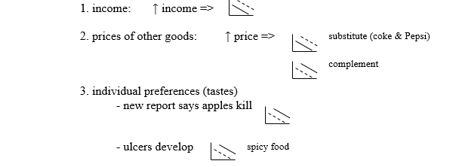

Demand Shifters

Slide 31
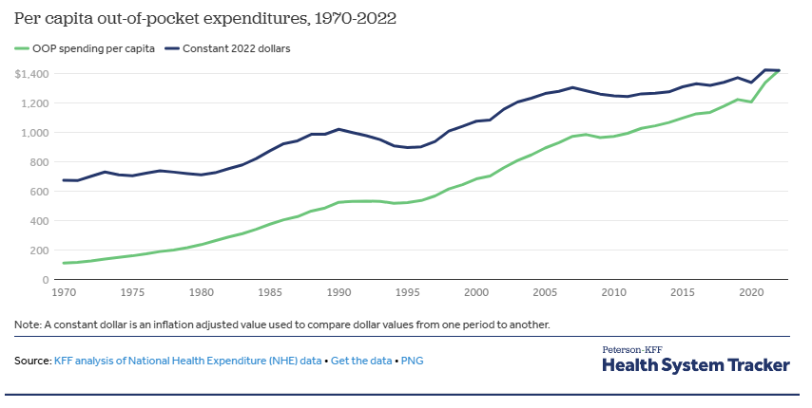
Impact of Health Insurance on Demand for Medical Care
Insurance impacts the prices consumers face
Notes:
Out-of-pocket payments for health care were almost half of total expenditures in 1960.
By 2021 they represented only about 11% of total expenditures.

Slide 32
How insurance changes market dynamics
Stage I: Market prices are established.
Private insurers negotiate/agree upon payment rates with providers. Most public programs set their own rates.
Stage II: Utilization levels are established.
Utilization is determined by individual-specific factors including prices faced by consumer (given market price levels, cost-sharing provisions) and other factors (e.g., health status, perceptions of quality)
Notes:
Two-stage demand model

Slide 33
Moral Hazard
Definition
Moral Hazard: a situation in which a party is incentivized to risk causing harm because another party is obligated to remedy the consequences of the harm caused
Consumers alter their behavior because they have insurance. They may:
Engage in riskier behavior: ex-ante moral hazard
Be less price sensitive: ex-post moral hazard

Slide 34

Moral Hazard
Examples of ex-ante vs. ex-post moral hazard?
→ Leads to increased utilization, choice of higher-priced providers

Slide 35
Rand Experiment: Effects of Cost Sharing on Demand
Cost-sharing scenarios:
No insurance
Insurance with 100% coverage
Copays: a fixed amount for services that is independent of the market price or actual costs of services
Coinsurance: fixed percentage share the individual is responsible for
Deductible: fixed amount that the consumer must pay out-of-pocket (per calendar year) before coverage kicks in.
→ Most US private insurance has deductible, copay AND coinsurance
Notes:
80s, families were offered different cost sharing insurances
Why would this not happen today?

Slide 36
Definitions: Market vs. Effective Demand
Definition
“Market (nominal) demand” (gray curves): how many visits the market would see at different total prices paid to the provider (what the insurer + patient together pay). This assumes the same underlying behavior of the patient & is expressed in terms of the full price per visit.
Definition
“Effective demand” (red curve): quantity of visits chosen as a function of the out-of-pocket price the patient actually pays.
→ Without insurance, market demand = effective demand
Notes:
“Market demand curve: visits as a function of the total price paid to providers (insurer + patient), holding underlying patient behavior fixed.”
“Effective demand: visits actually realized at the patient’s out‑of‑pocket price implied by a given insurance contract (copays, coinsurance, deductibles).”

Slide 37
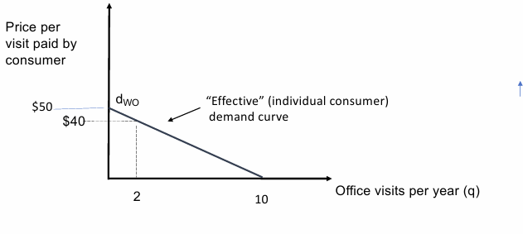
No insurance
Notes:
Effective Demand:
What you want and can afford
Nominal Demand:
What you want

Slide 38
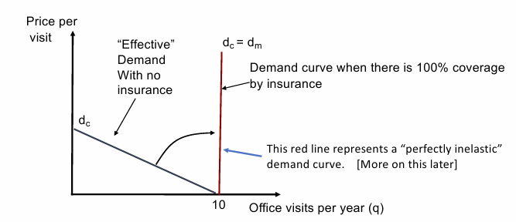
100% coverage

Slide 39
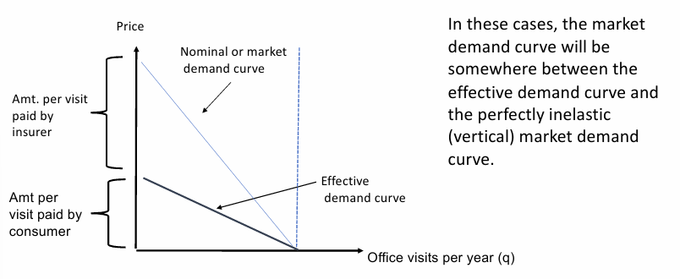
Cost-sharing

Slide 40
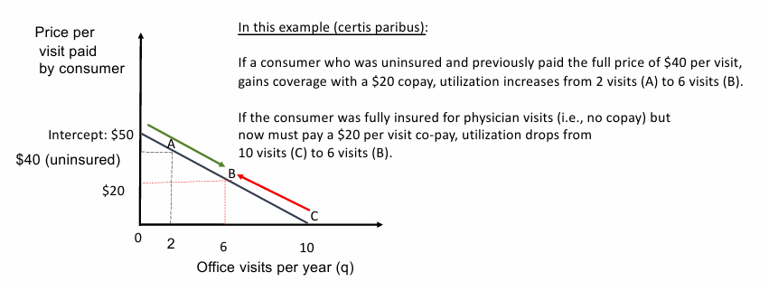
Cost-sharing: Copayments
Notes:
Copay leads to movement along the curve, not movement of the curve
Price axis is the total price the provider receives.
A fixed copay means the patient always pays, say, 20 dollars, regardless of what the provider charges; as the provider price varies, the patient still faces 20, so the patient’s decision rule is vertical at the quantity chosen at 20 and does not trace out a standard downward‑sloping curve in provider‑price space.
A coinsurance rate (e.g., 20%) means the patient pays a constant fraction of the provider price, so as provider price rises, the patient’s out‑of‑pocket price rises proportionally; that gives you a conventional downward‑sloping demand curve as a function of provider price, and changing the coinsurance rate rotates/shifts that curve.

Slide 41
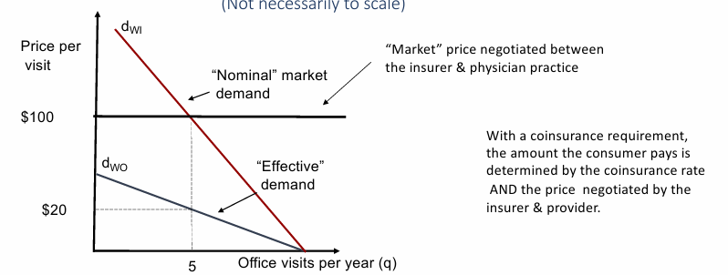
Cost-sharing: Coinsurance
Price per visit received by the provider
Notes:
If you draw a vertical line from any point on the nominal demand curve to the horizontal axis, you can break down the amount paid by consumers (from the horizontal axis to the dWO curve) and the amount paid by the insurance carrier (the wedge between the dWI and dWO curves). As the coinsurance rate falls, dWI rotates upward and pivots off the point where the two curves cross the horizontal axis.

Slide 42
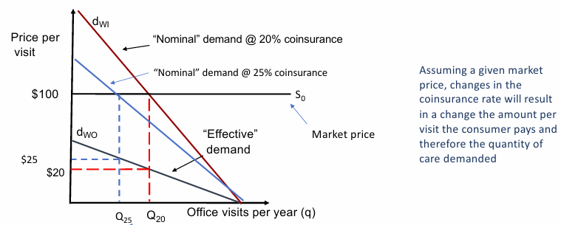
Cost-sharing: Coinsurance
Notes:
If you draw a vertical line from any point on the nominal demand curve to the horizontal axis, you can break down the amount paid by consumers (from the horizontal axis to the dWO curve) and the amount paid by the insurance carrier (the wedge between the dWI and dWO curves). As the coinsurance rate falls, dWI rotates upward and pivots off the point where the two curves cross the horizontal axis.

Slide 43
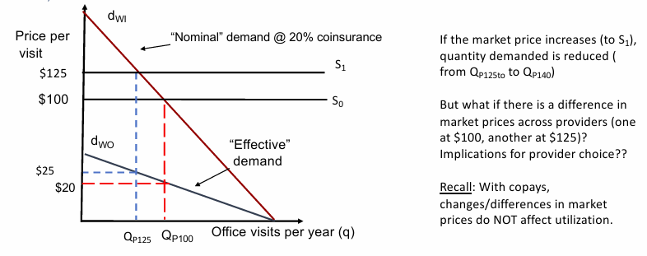
Cost-sharing: Coinsurance
Notes:
If you draw a vertical line from any point on the nominal demand curve to the horizontal axis, you can break down the amount paid by consumers (from the horizontal axis to the dWO curve) and the amount paid by the insurance carrier (the wedge between the dWI and dWO curves). As the coinsurance rate falls, dWI rotates upward and pivots off the point where the two curves cross the horizontal axis.

Slide 44
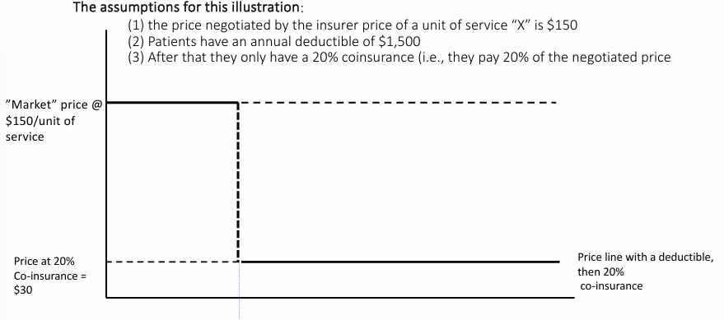
Cost-sharing: Deductible

Slide 45
Closing the loop: RAND
Rand Health Insurance Study: large randomized control trial (RCT) study conducted in the 1970s. Looked at service-centered cost-sharing, rather than on premium-sharing requirements.
Main findings:
Higher cost-sharing → lower utilization
Higher impact on initiation of care, not level of care once treatment started
Larger impacts on low SES, persons with disabilities
Decrease use of low value and high value care
Notes:
2. Why 2 is happening:
Intensive margin → more clinical decision making; extensive margin more up to the patient
Out of pocket max

Slide 46
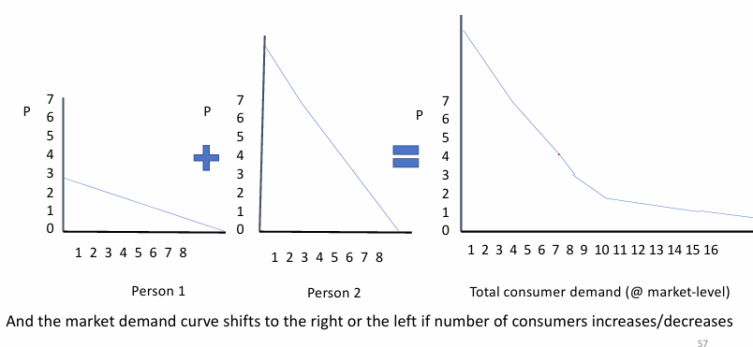
Aggregate demand = Σ individual demand curves

Slide 47
Last thoughts & Break
The widespread presence of health insurance in the US has:
↑ the affordability of medical care for many
↑ the demand for & utilization of medical care
•But… Because we have not been able to effectively contain prices, it has contributed to the rapid growth in prices and medical care spending over time and therefore has created problems of affordability
Notes:
for many (the uninsured & the under-insured)

Slide 48
Elasticities

Slide 49
Elasticities
Demand-side elasticities measure the responsiveness of quantity demanded (i.e., how much it changes) due to a change in an independent factor.
% change in one variable brought about by a 1 percentage change in some other variable.
Three types of demand-side elasticities:
Own-price elasticities
Cross-price elasticities (associated with complements & substitutes)
Income elasticity of demand

Slide 50


Own Price Elasticity
Definition
The extent to which consumers alter their consumption of a good or service when the price of that good or service changes. E ≤ 0

Slide 51
Own price elasticities - classifications
|E| > 1 → |%ΔP| < |%ΔQ| → Elastic demand
%Δ in quantity demanded is greater than the percentage change in the price
|E| = ∞ → Perfectly elastic demand
|E| < 1 → |%ΔP| > |%ΔQ| → Inelastic demand
%Δ in quantity demanded is smaller than the percentage change in the price
|E| = 0 → Perfectly inelastic demand
|E| = 1 → |%ΔP| = |%ΔQD| → Unit elastic demand
%Δ in quantity demanded is the same as the percentage change in the price
Notes:
[Class participation ] → ask for examples of each

Slide 52

Cross-price elasticities
Defined as the percent change in the demand for good A for each one percent change in the price of good B.
If E > 0 is positive, the goods are substitutes
If E < 0 is negative, the goods are complements.

Slide 53

Income elasticity of demand
Defined as the percent change in demand resulting in each one percent change in income.
. If E<0, the good is an inferior good
If E>0, the good is a normal good

Slide 54
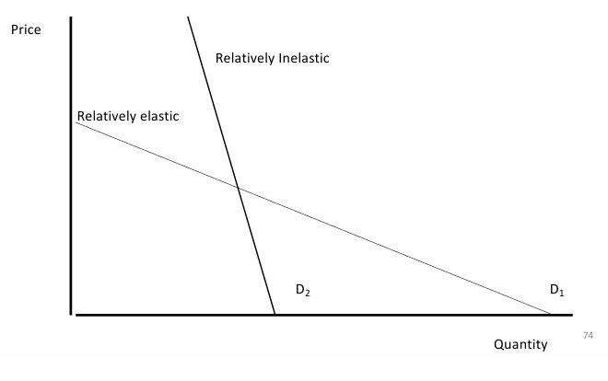
Recall: Economic variables that impact demand
Shape or slope of the curve indicates the responsiveness of demand to prices

Slide 55
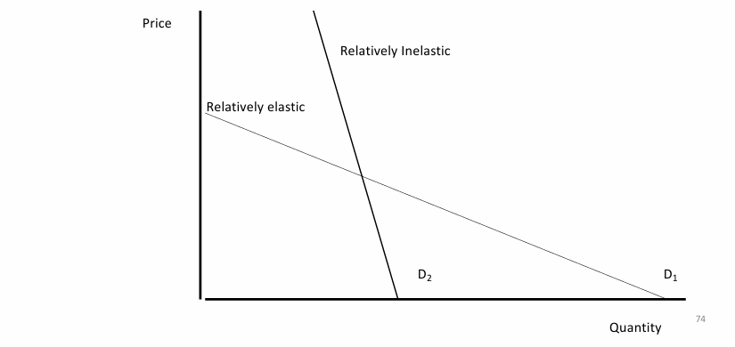
Flatter curve → higher elasticity

Slide 56
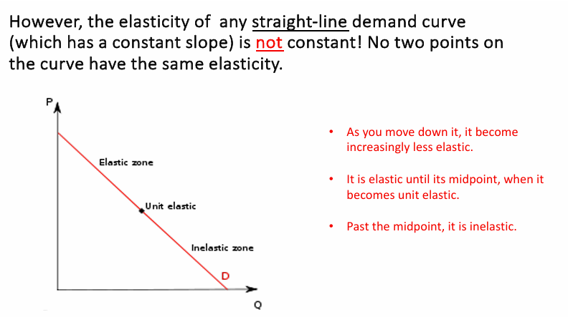

Slide 57

Normal vs. Inferior Goods
Definition
Normal Good: as income increases, the consumer spends at least a portion of the increase in purchasing power on additional physician services.
→ Vs. Inferior good: demand declines when income rises

Slide 58
Normal vs. Inferior Goods
Definition
Normal Good: as income increases, the consumer spends at least a portion of the increase in purchasing power on additional physician services.
→ Vs. Inferior good: demand declines when income rises
Medical care is assumed to be a “normal” good.

Slide 59
